Slide 1


Animal Rescue
2
+
WINTER EDITION
Apáczai Csere János High School Cluj-Napoca
Created by: Nagy Timea and Velican László

Slide 2


ABOUT THE PROJECT
2
+
We created a game named Animal Rescue Winter Edition
The main characters are animals
There are five levels
The main goal is to help the animals reach their lost kids through platforms
There are bonuses that add plus points to the score
There are enemies, who can kill you if you don’t avoid them
There is a minigame
The main character’s codes are commented in the bear’s code only, because in the rest the code is almost the same.
2
+

Slide 3


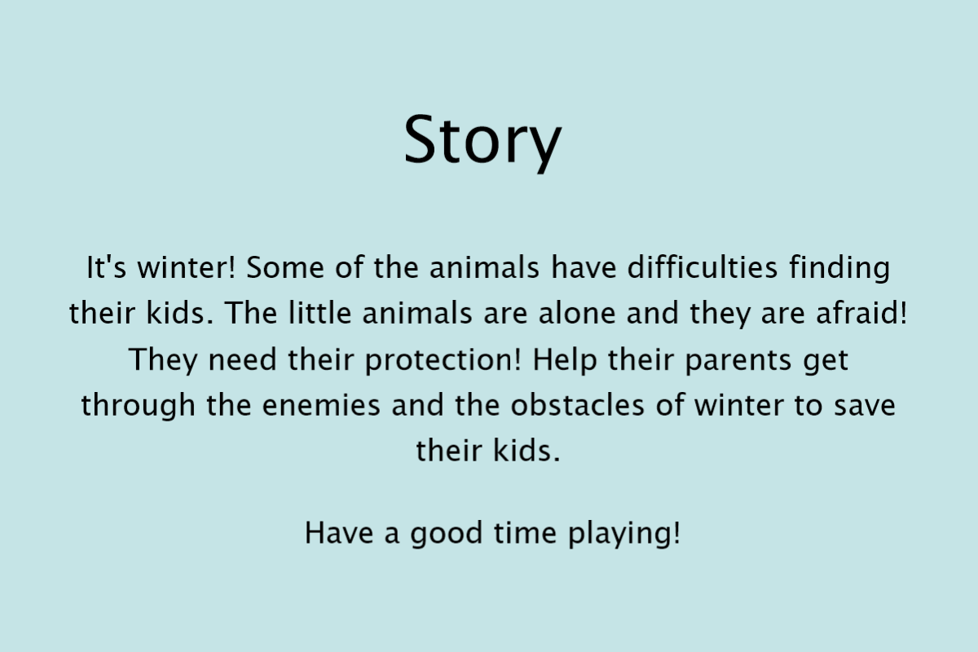
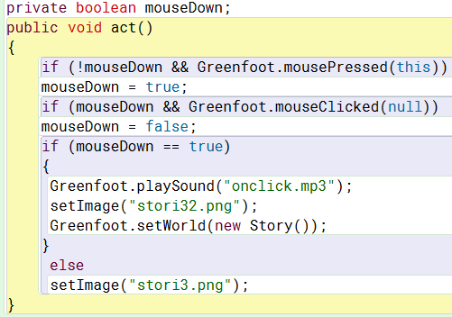
story
When you click on the Story button, the Story will appear
The other buttons work the same
The code of the Story button:

Slide 4
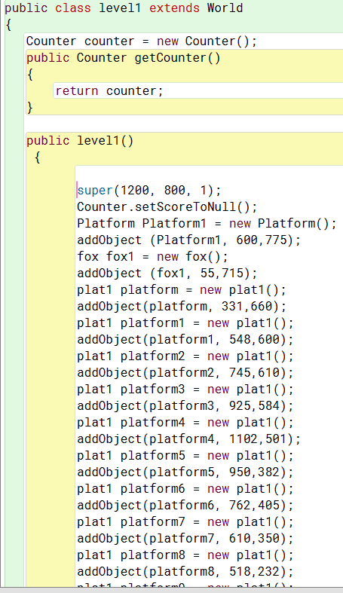


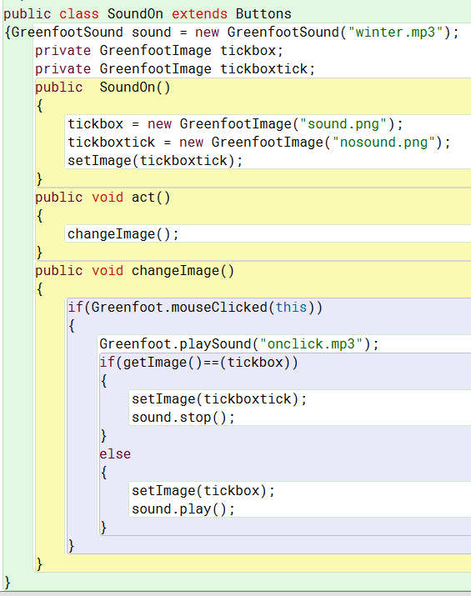
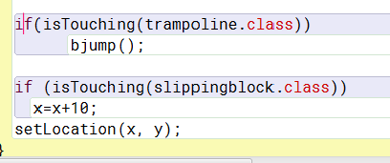
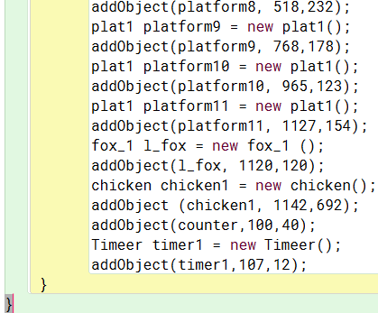


Level 1 code and trampoline, slipping block
THE SOUND
This is the sound button. When you click on it, the background sound starts/stops and the button changes
When the bear steps on a slipping block, he will slide to right and fall down.
When the bear reaches the trampoline, he will jump higher

Slide 5

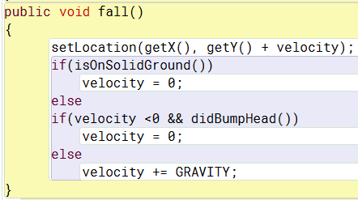
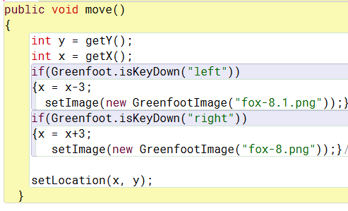
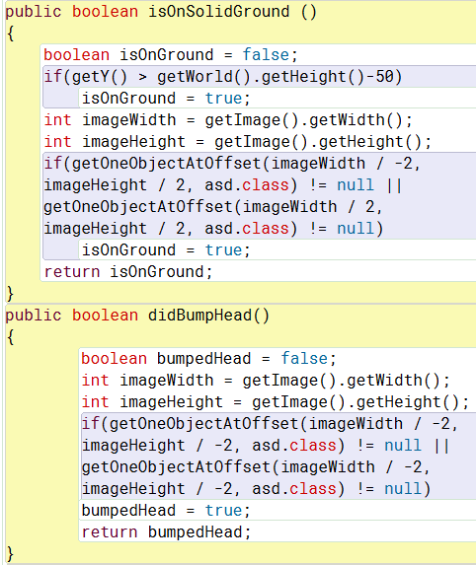


Main character movement
Falling
Left – Right movement and Jump
Checks whether the character is or is not on solid ground
When the animal’s direction changes, the icon of the animal will change in that direction too
Checks whether the character is or is not on any platform

Slide 6
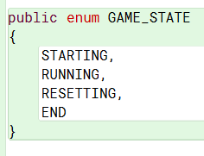

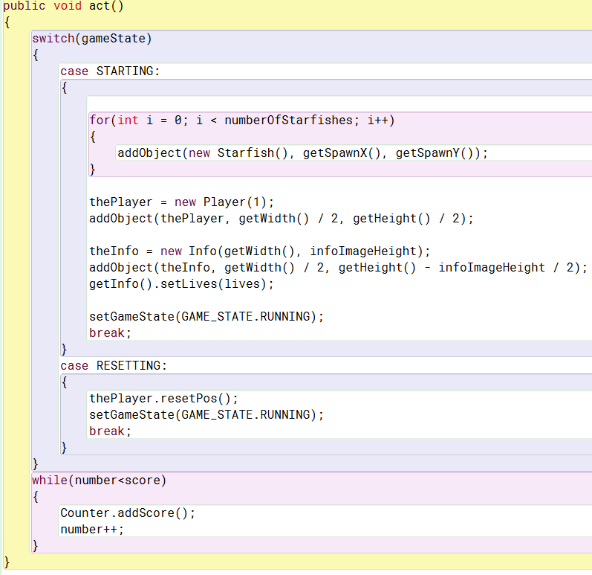



minigame
A piece of the Minigame`s code:
In the $5^{th}$ level there is a Minigame
The Minigame’s icon is a crab
When the reindeer touches the crab, the Minigame world will appear
In the Minigame you have to collect Starfishes with another crab
A collected Starfish is 1 point
You have 3 lives and when you die, your score drops by half
Your highest score will be added to your total score
This is the part which adds the score earned in the Minigame to the total score

Slide 7
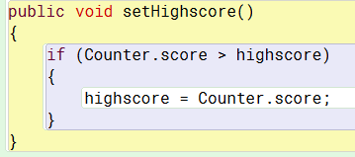
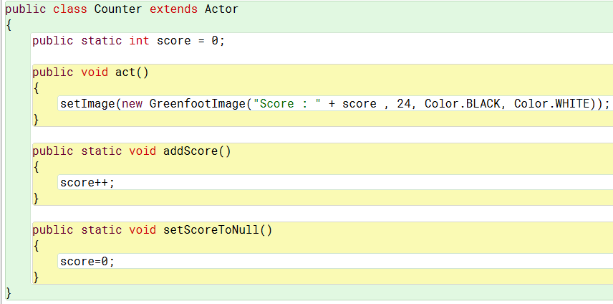
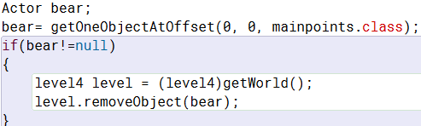
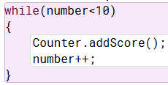
Scoreboard
This is the code for the Highscore:
This is the code for the score counter:
The highscore variable is a public static variable. This way it won’t change to 0 during the game.
With the following code, we added points to the score. We used this for adding points for the bonus animals and plants
When an animal collects a bonus, the bonus disappears from the screen

Slide 8
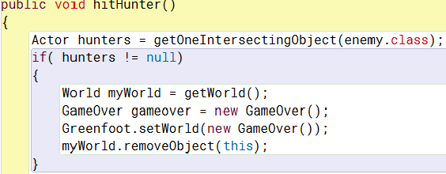
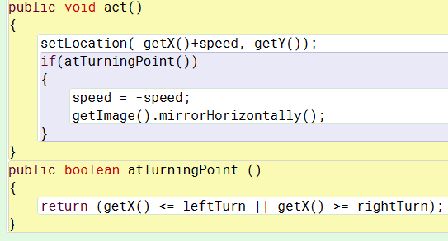
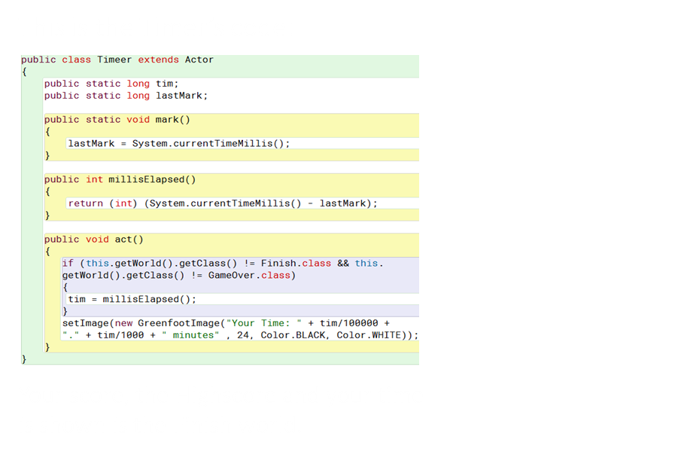
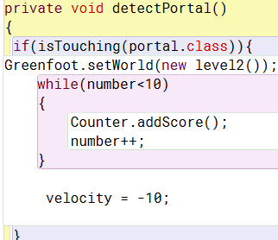
Enemies timer and the portal class
When an enemy is intersecting with an animal, the game ends and the Game Over screen appears
This is the code for the movement of the enemies:
We made a class for the portals. The portals are the little animals which teleport you to the next level or to the finish.

